Slide 1
Disparities in Computer Science Representation
Minorities in Computer Science
CPSC-230-06
Interterm 2021
Elia Eiroa Lledo

Slide 2
Why We Should Care About Diversity in the Computational Sciences

Slide 3
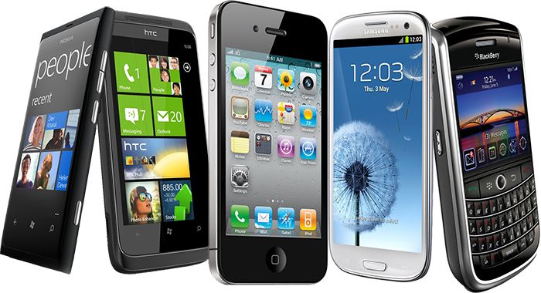





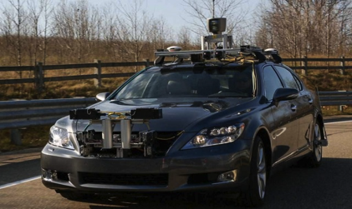
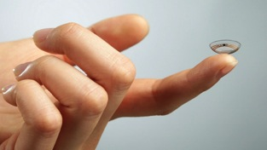
Technology Affects Every Field

Slide 4
Why Should we Care?
Computer Scientists (Software engineers, data scientists, computer engineers, etc.) are shaping the world as we know it
Without adequate representation in these jobs, innovations might not align with the needs of society’s demographics
Could lead to institutional discrimination
Example: algorithm was less likely to refer black people than white people who were equally sick to programs that aim to improve care for patients with complex medical needs.
Obermeyer Z, Powers B, Vogeli C, Mullainathan S. Dissecting racial bias in an algorithm used to manage the health of populations. Science. 2019 Oct 25;366(6464):447-453. doi: 10.1126/science.aax2342. PMID: 31649194.
Notes:
https://www.nature.com/articles/d41586-019-03228-6

Slide 5
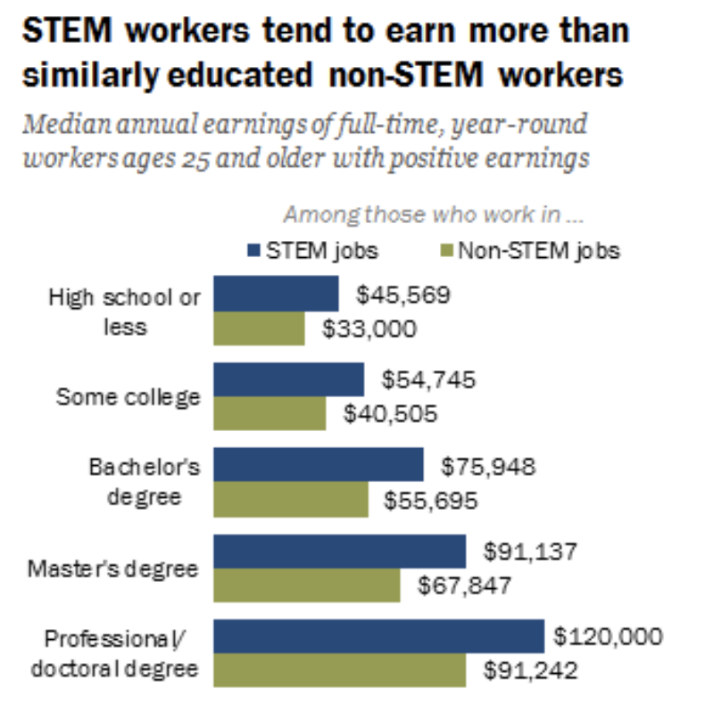
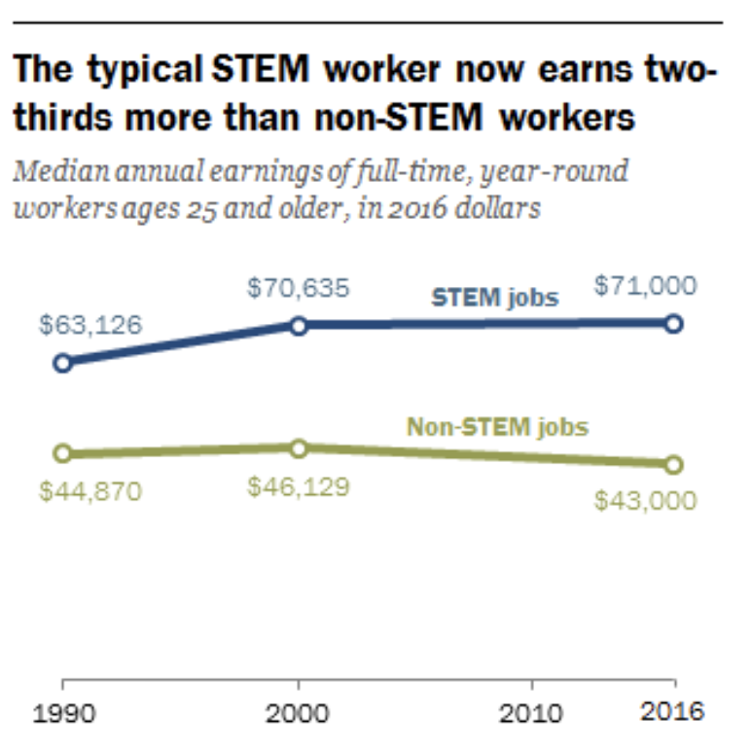
Why Should we Care?

Slide 6
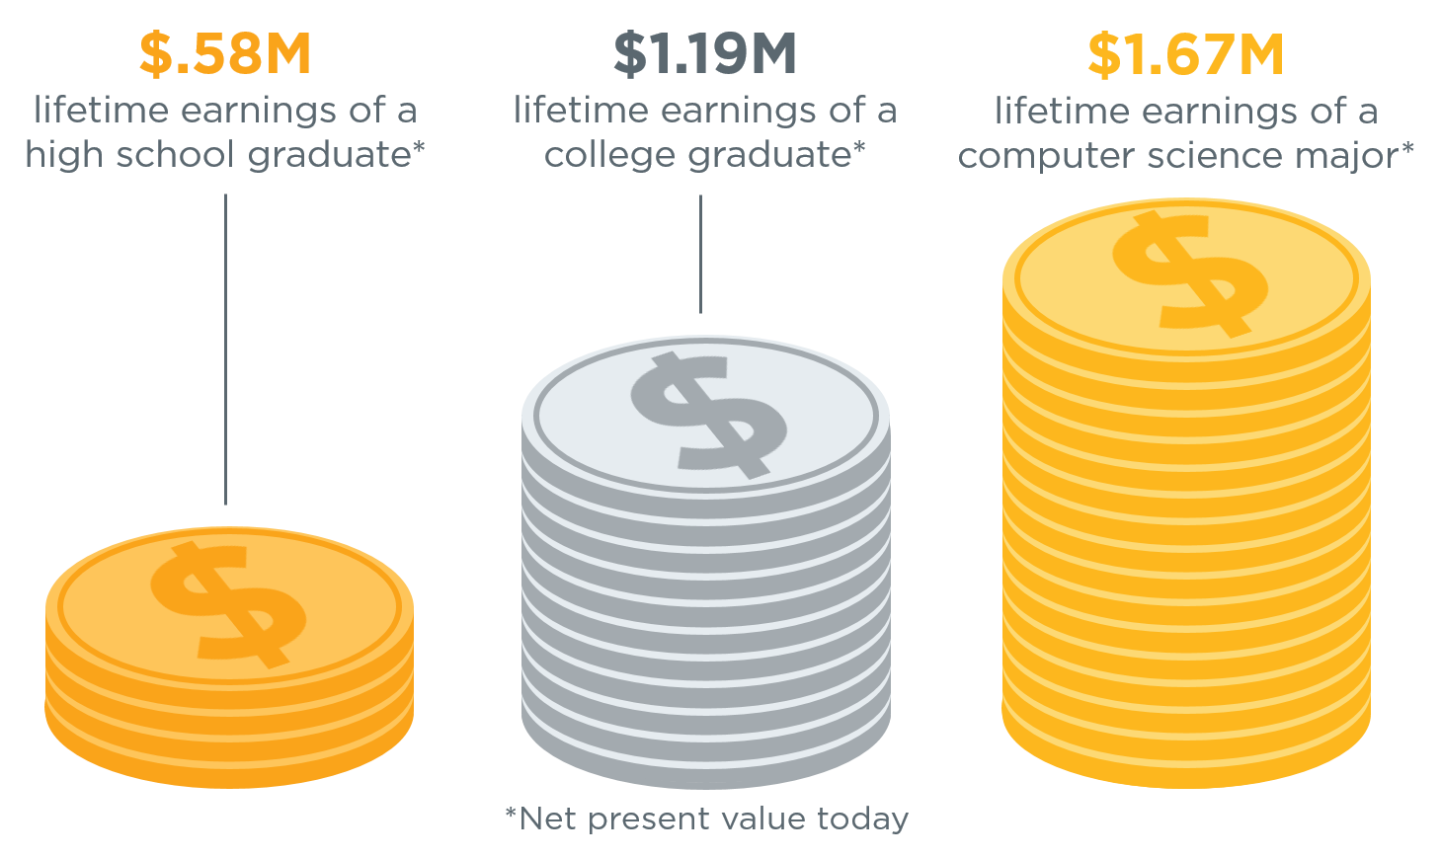
Why Should we Care?
Sources: Bureau of Labor Statistics, National Center for Education Statistics

Slide 7
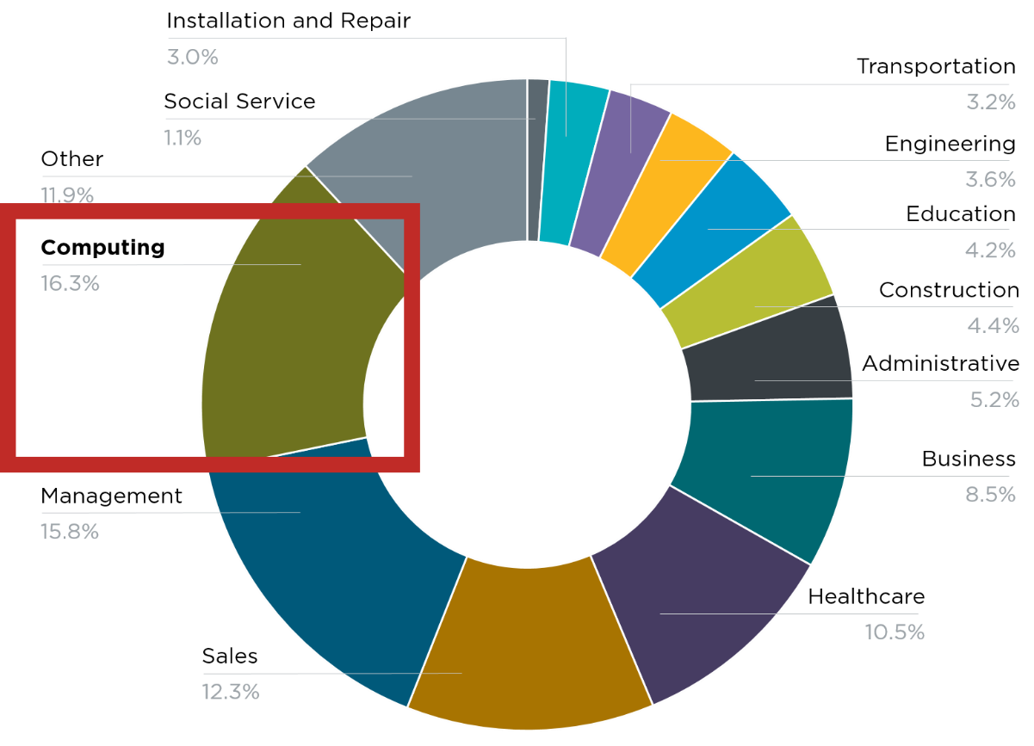
Why Should we Care?
500,000 current openings:
These jobs are in every industry and every state, and they’re projected to grow at twice the rate of all other jobs.
Sources: Bureau of Labor Statistics, National Center for Education Statistics

Slide 8

Why Early Intervention Helps
K-12 computer science
University computer science
Software workforce
Women who try AP Computer Science in high school are ten times more likely to major in it in college, and Black and Hispanic students are seven times more likely.
Sources: Bureau of Labor Statistics, National Center for Education Statistics

Slide 9
The Gaps

Slide 10
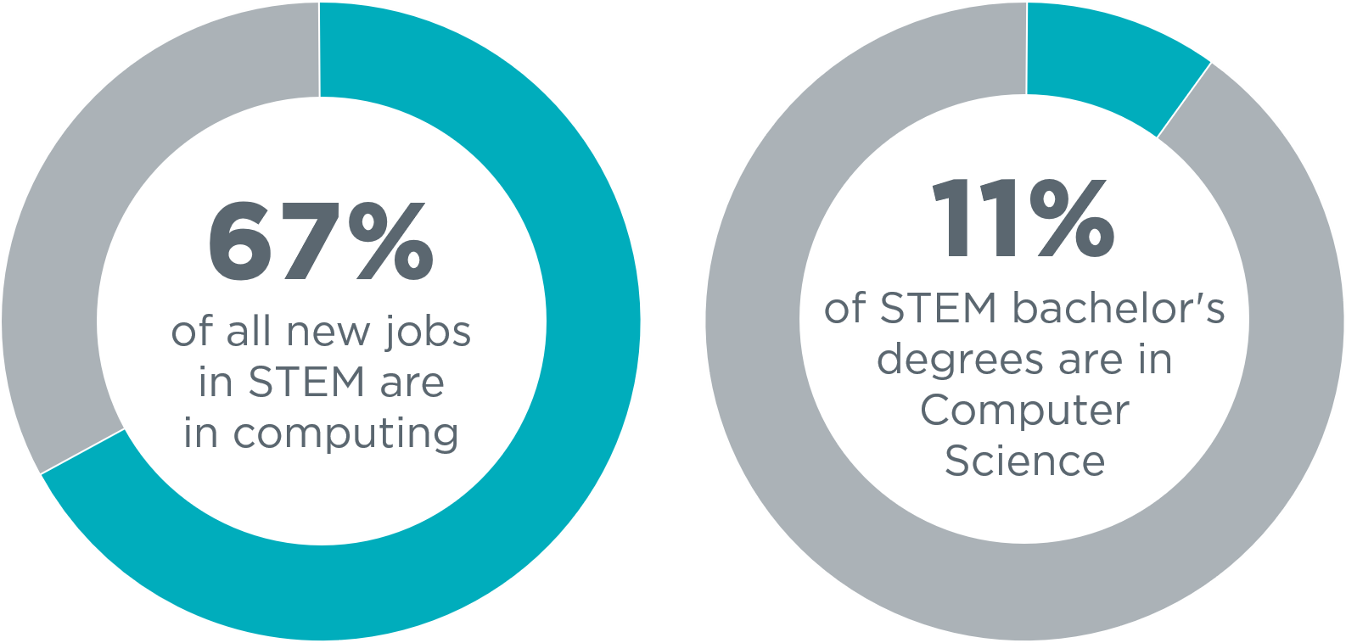
The Gaps
500,000 current openings:
These jobs are in every industry and every state, and they’re projected to grow at twice the rate of all other jobs.
Sources: Bureau of Labor Statistics, National Center for Education Statistics

Slide 11
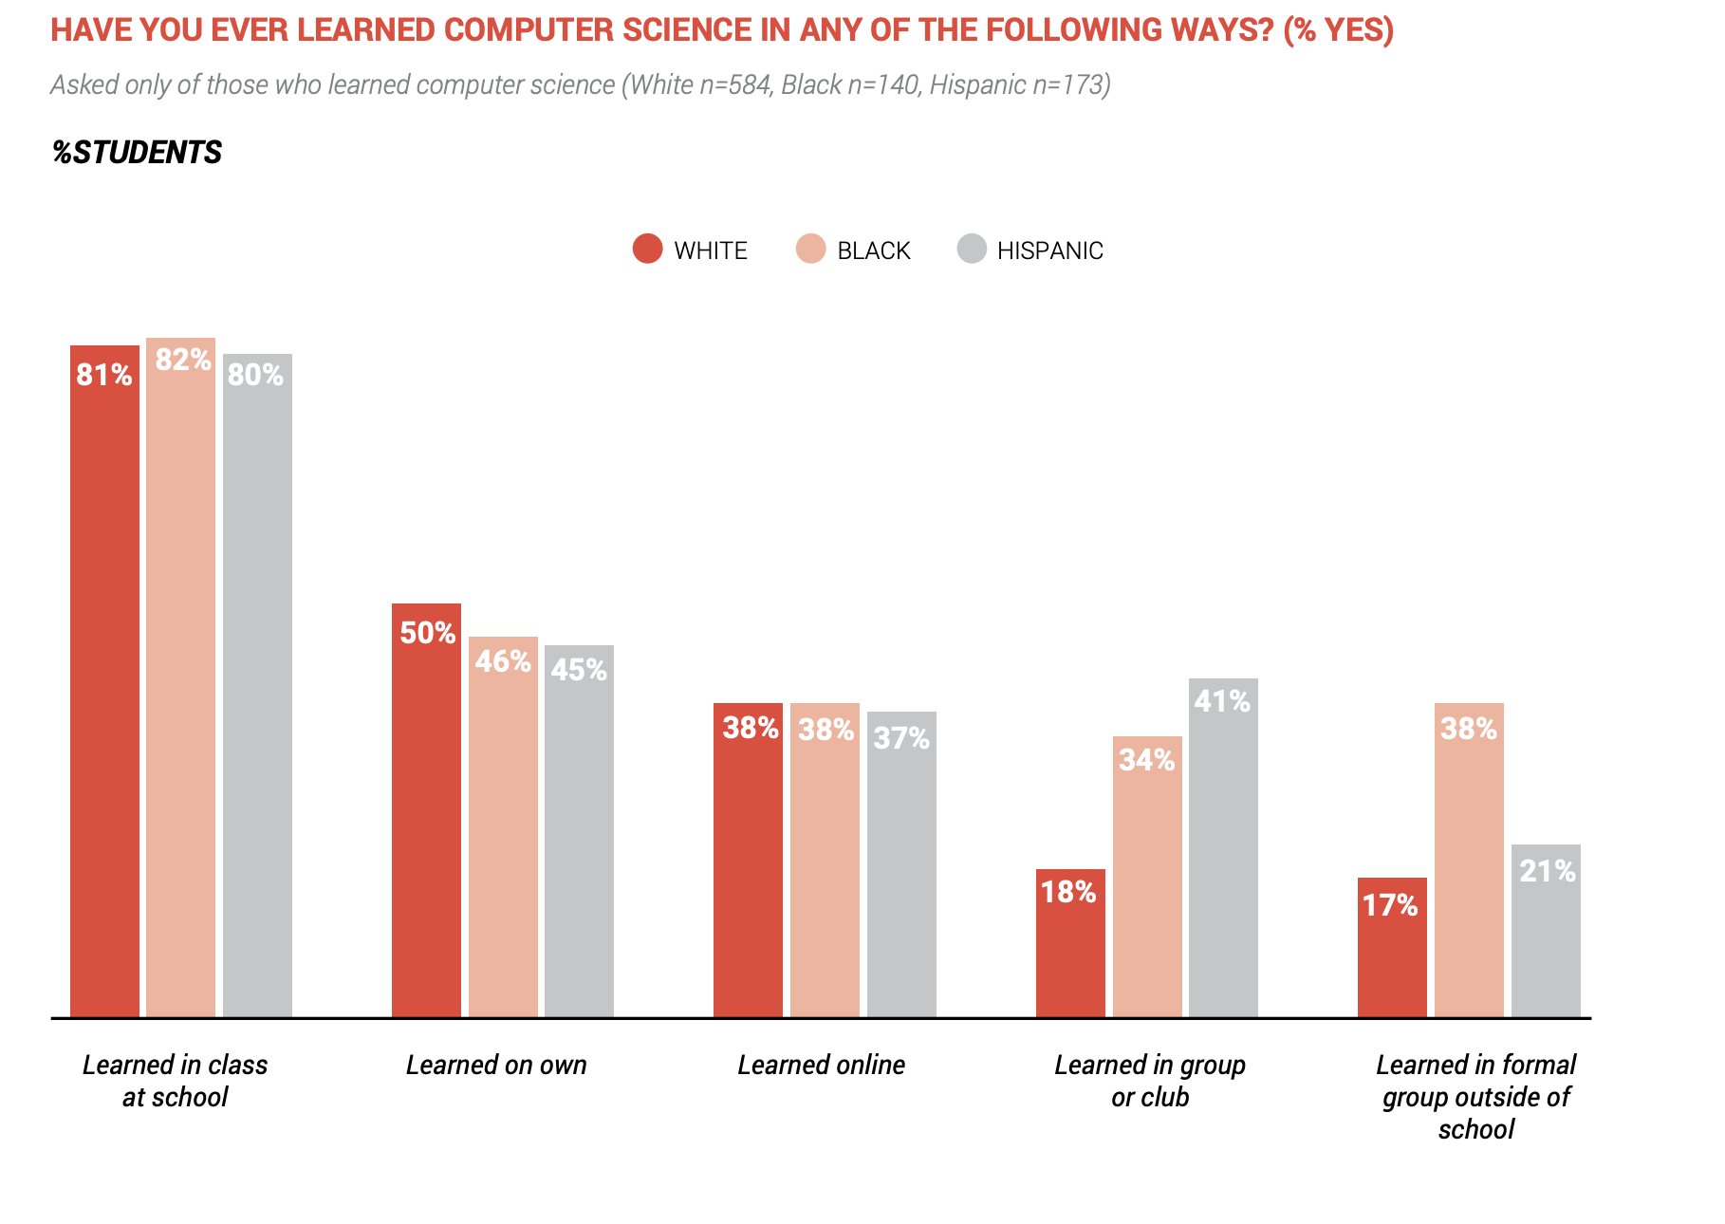

Slide 12
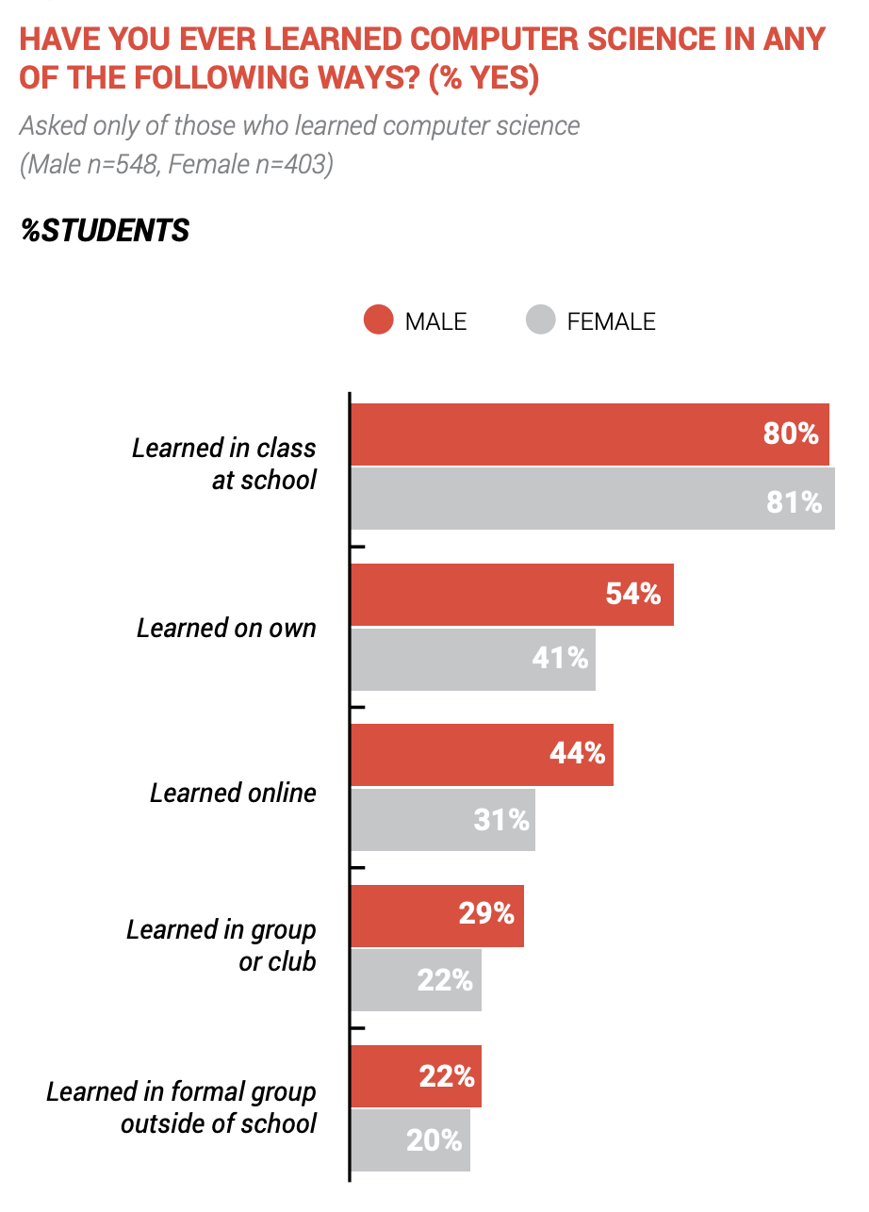

Slide 13
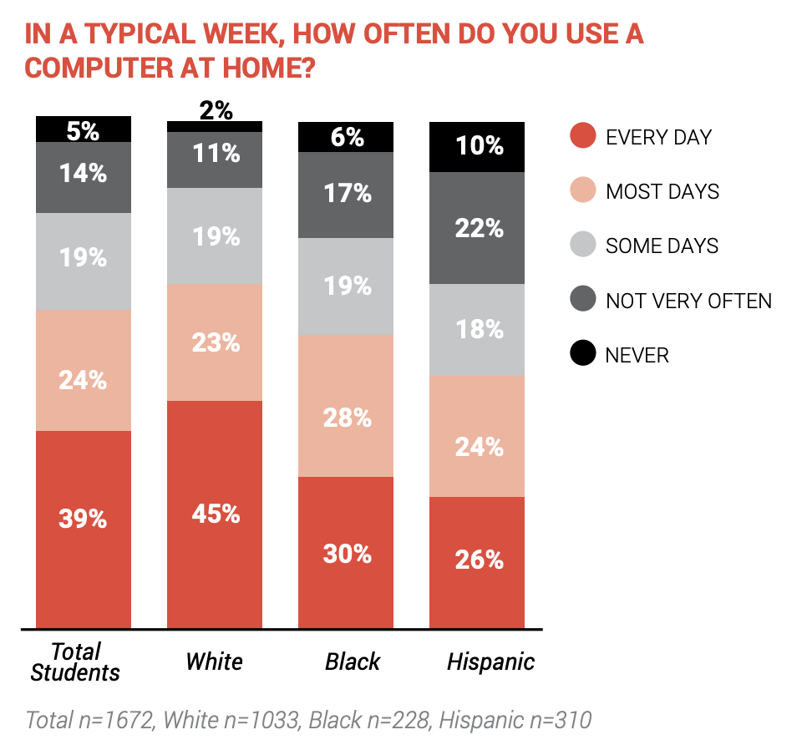
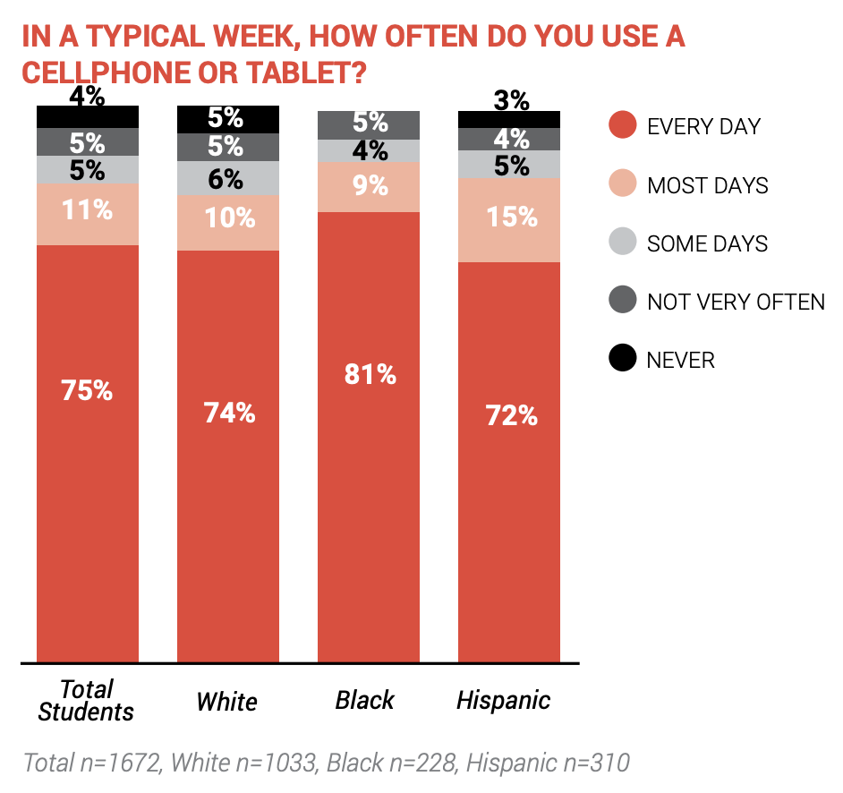
Exposure to Technology
Home Computer Access Is Higher Among White Students, With Large Majorities of All Students Reporting Daily Cellphone Usage

Slide 14
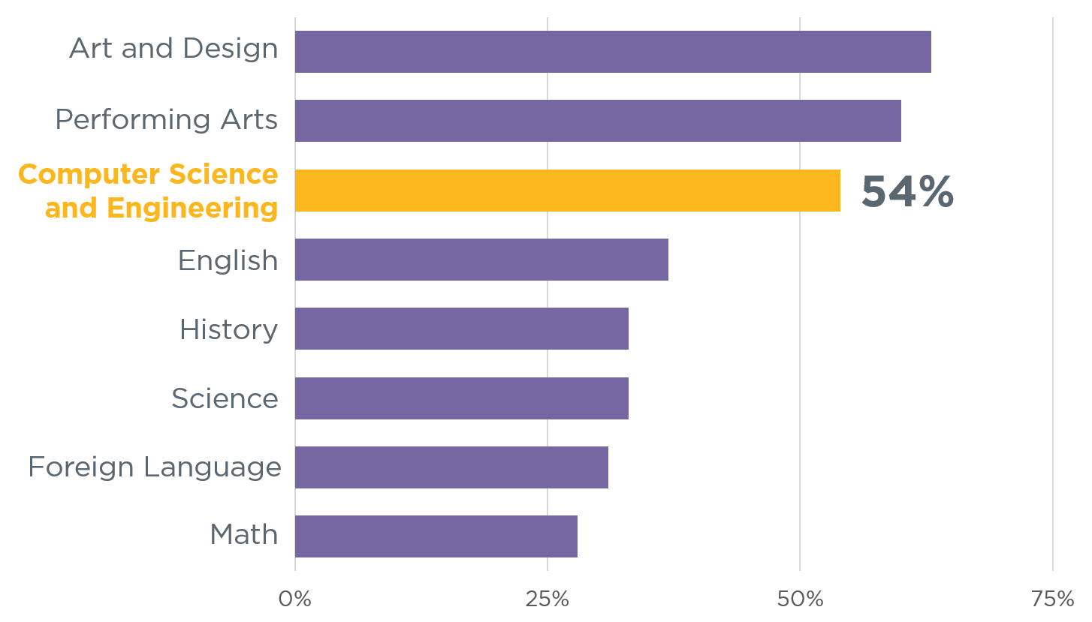
It is Not a Matter of Whether C.S. is Enjoyable
Students Love Computer Science and Art the Most
Source:
Change the Equation

Slide 15
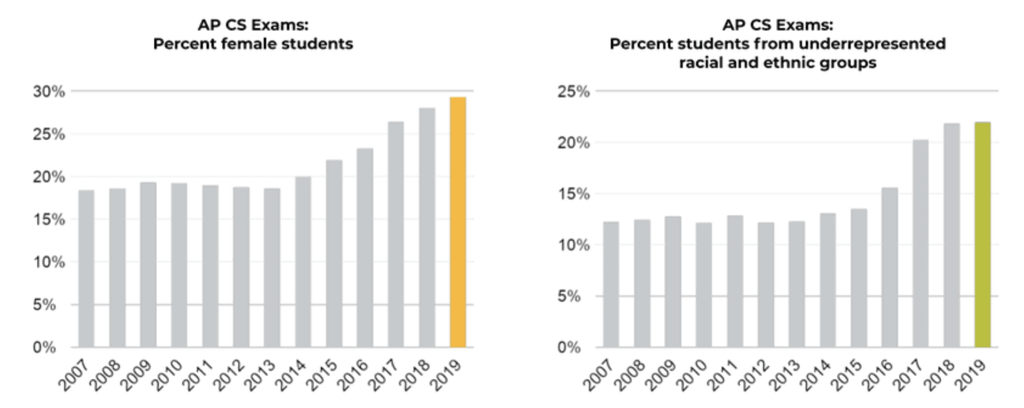
It’s Not a Matter of Whether Girls and Racial Minorities are Interested…
https://code.org/diversity

Slide 16
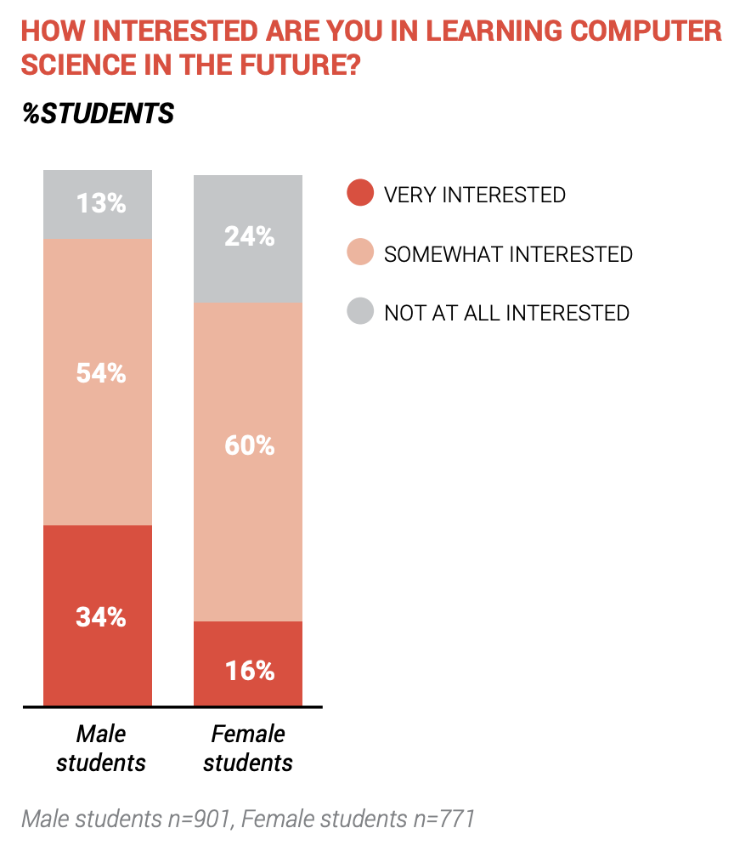
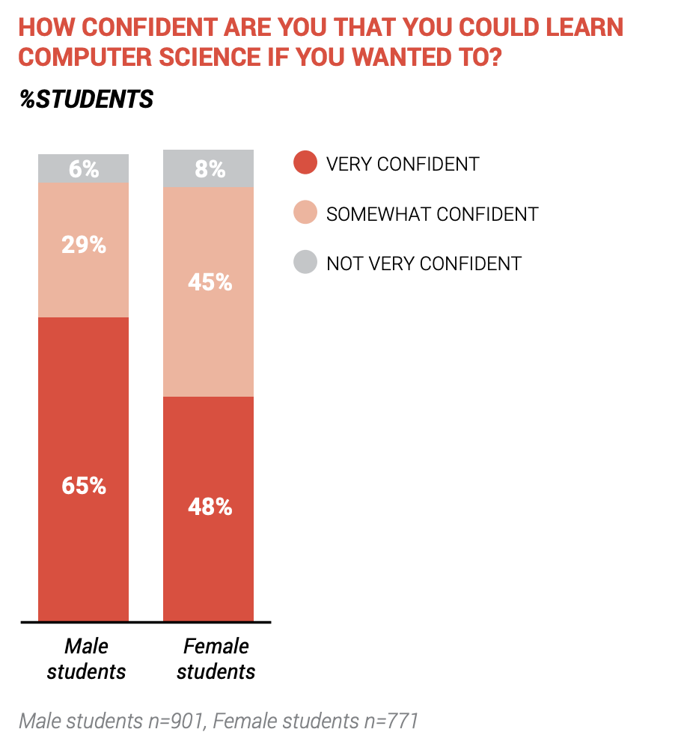
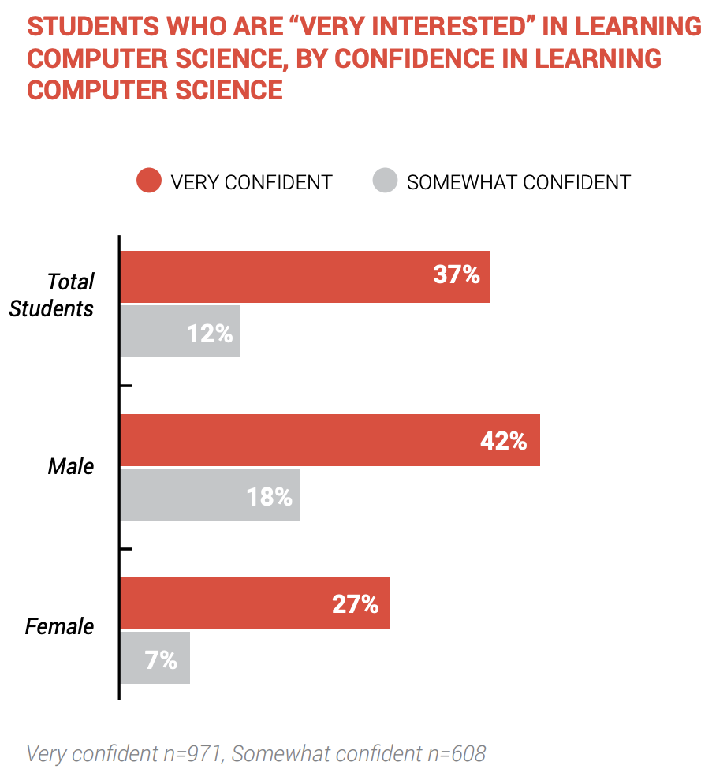
Interest and Confidence in Learning Computer Science

Slide 17
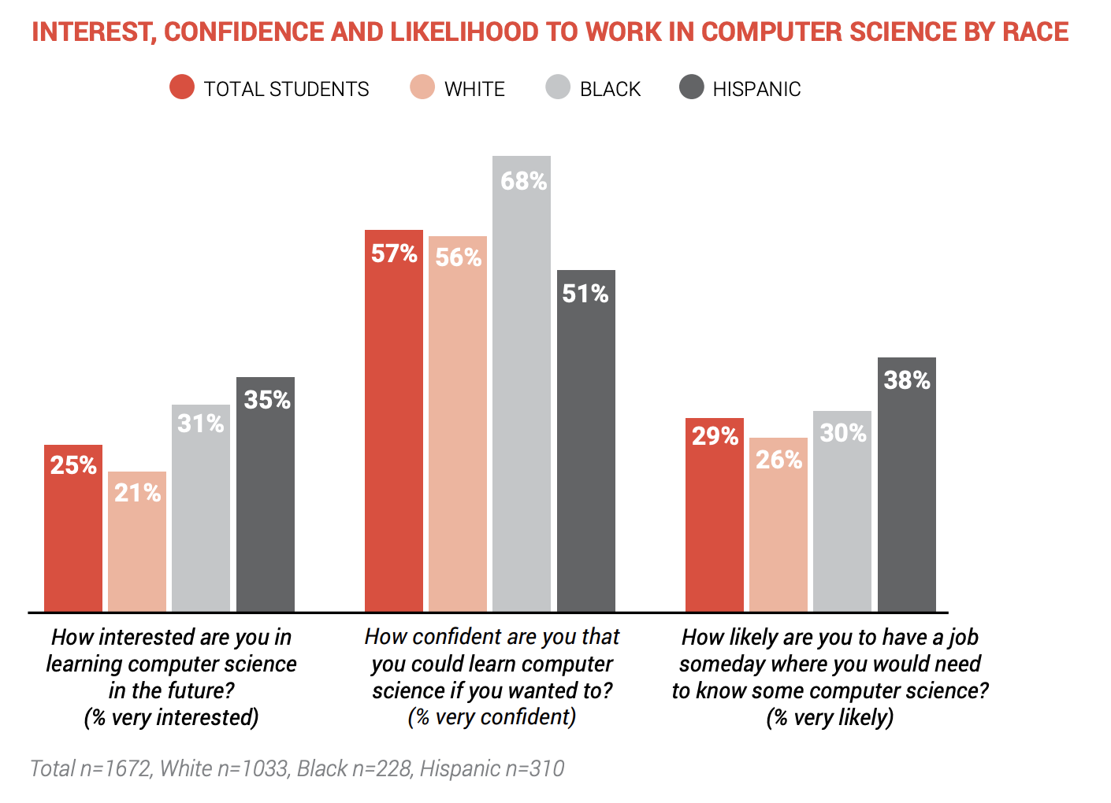

Slide 18
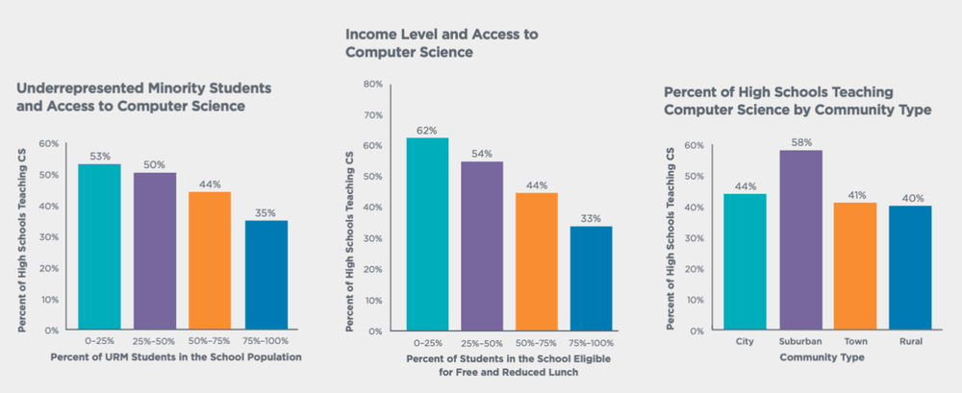
Unequal Access
Studies show children who study computer science perform better in other subjects, excel at problem-solving, and are 17% more likely to enroll in college. But access to computer science is unequal.

Slide 19
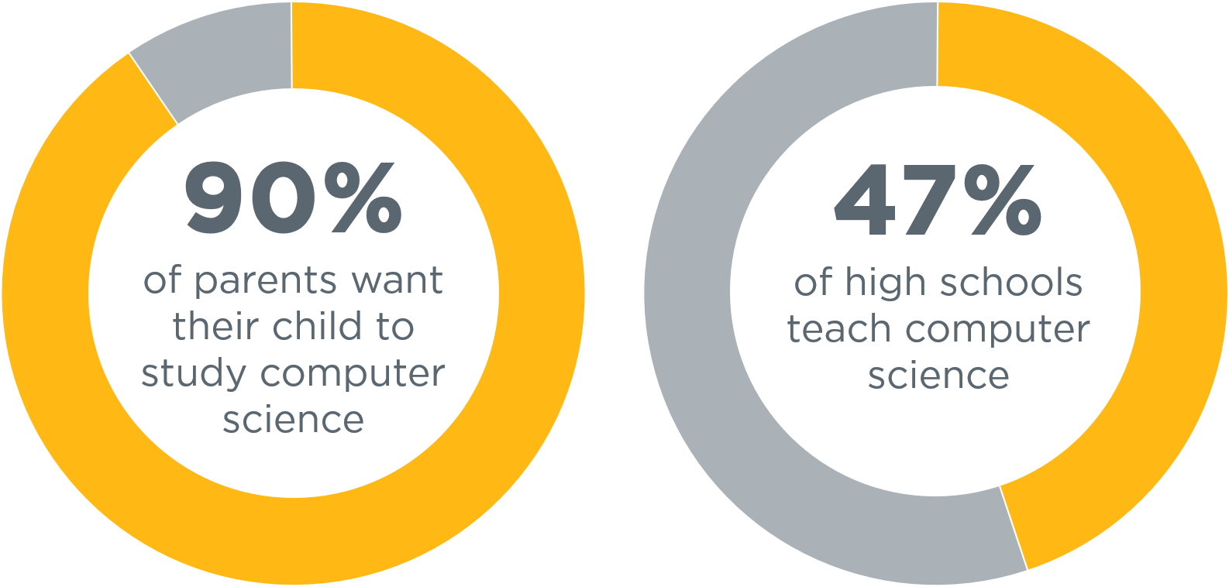
We Need to Close the Gaps
Source: Access Report

Slide 20
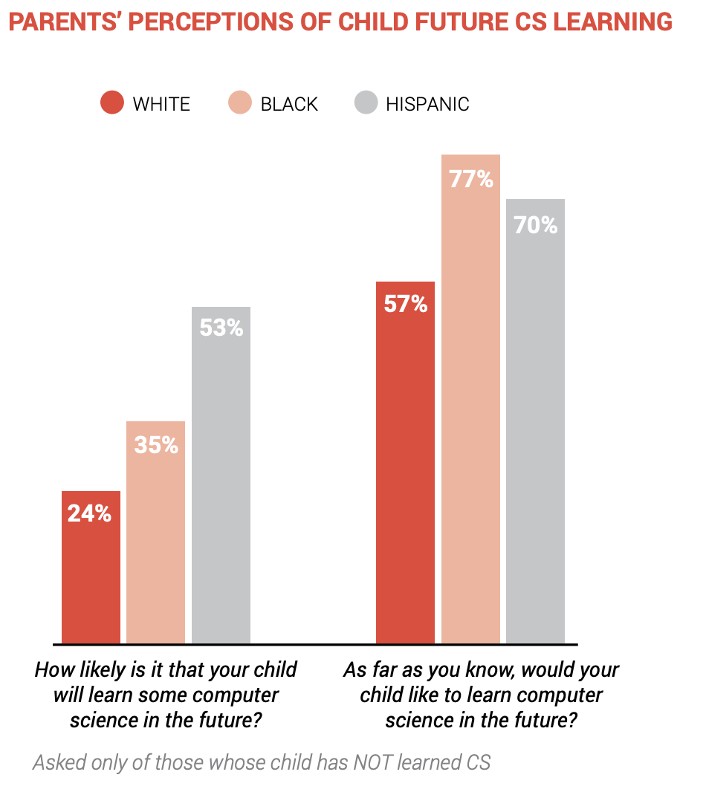

Slide 21
Views of People in Computer Science
K-12 Girls

Slide 22
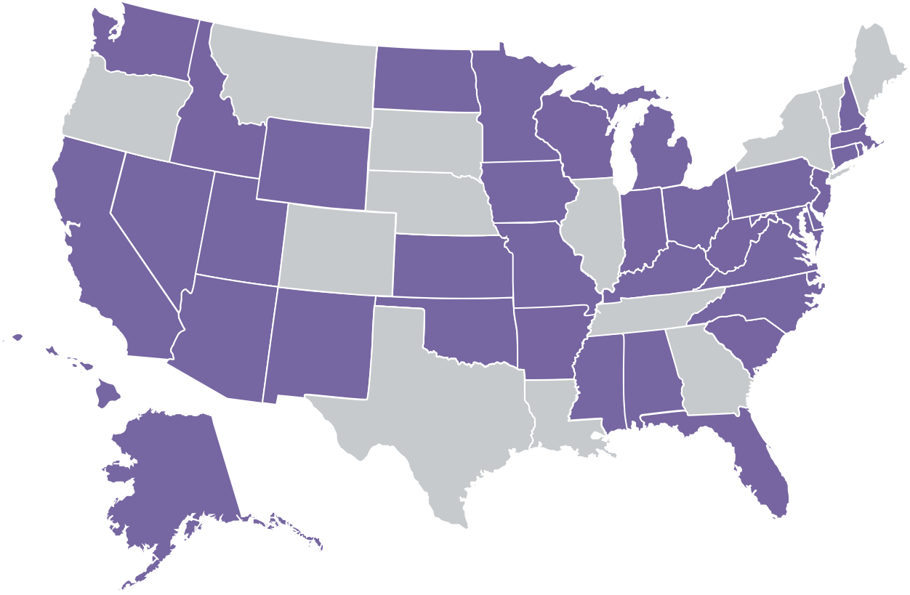
So What Is It? The State of K–12 Computer Science Standards
Only 37 states have created K–12 computer science standards.
Momentum is building, but we still have a long way to go.
States with K–12 CS standards
States without K–12 CS standards
Sources: Bureau of Labor Statistics, National Center for Education Statistics

Slide 23
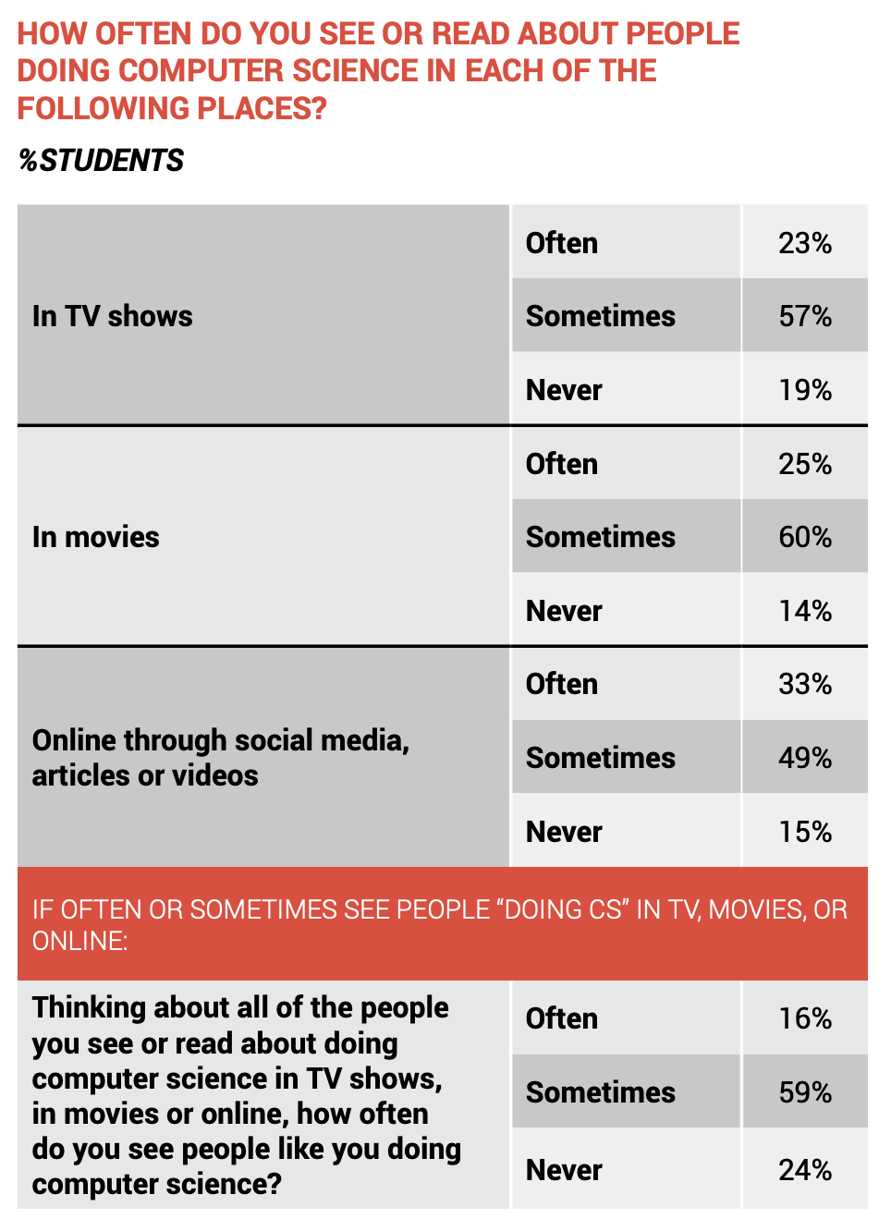

Slide 24
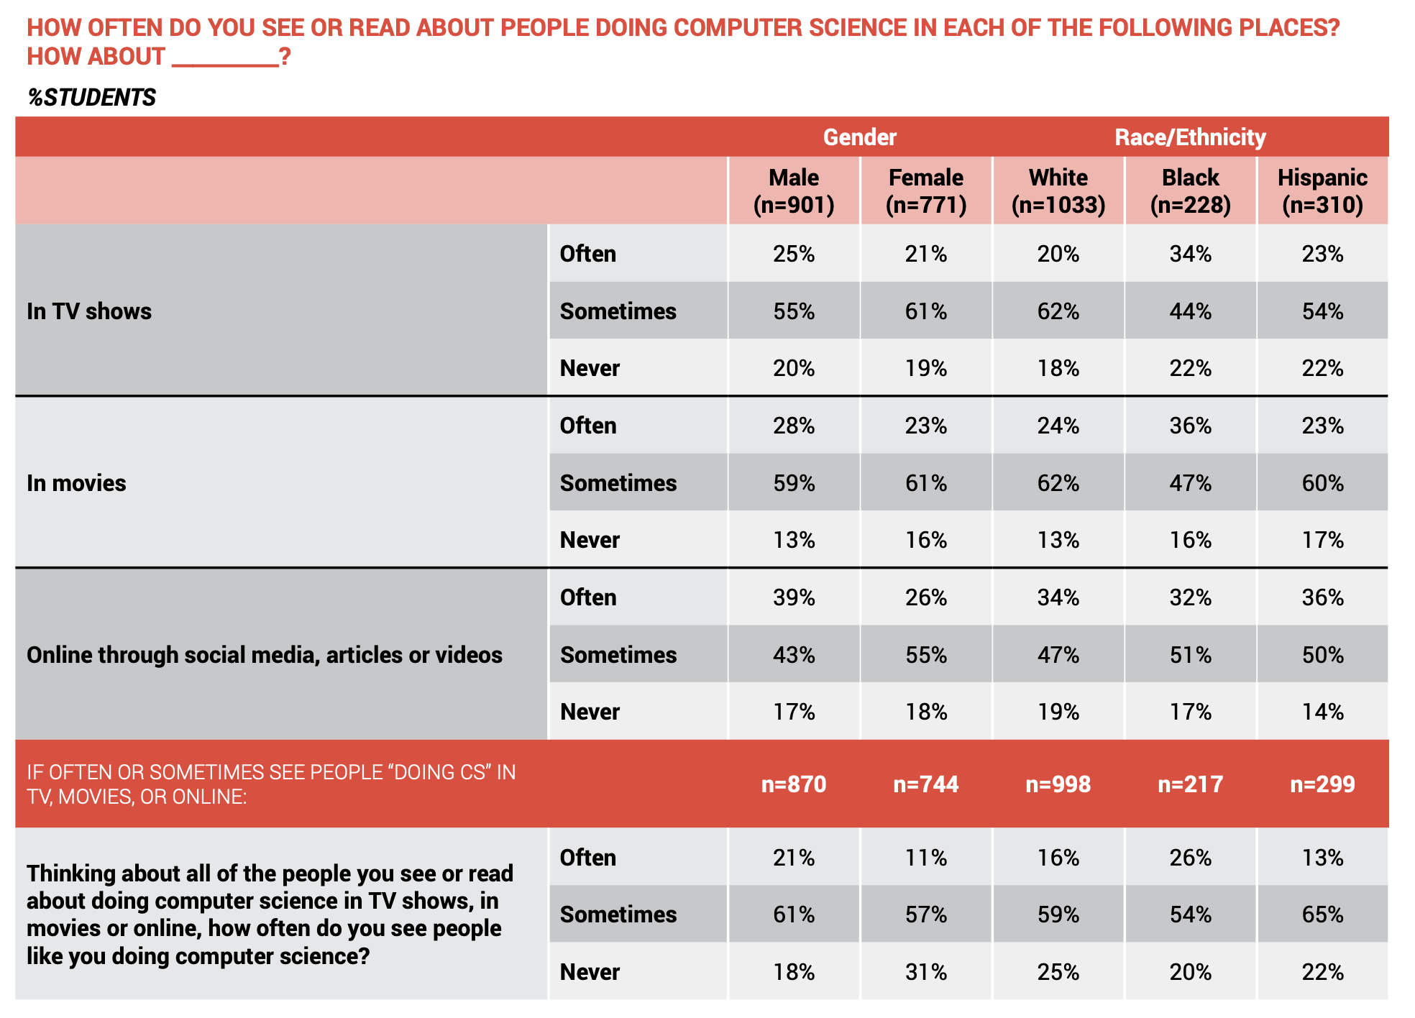

Slide 25
Encouragement
K-12 Girls

Slide 26
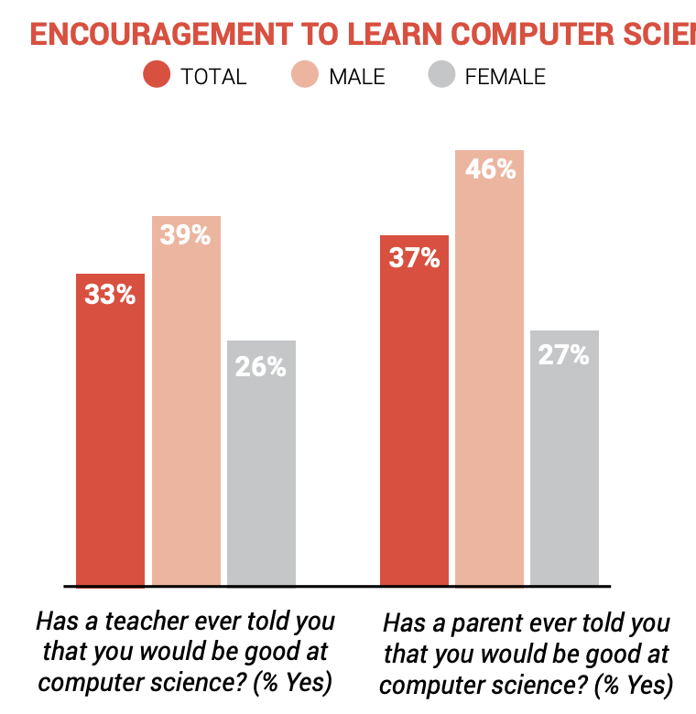

Slide 27
Perceived Reasons for Underrepresentation of Certain Groups in Computer Science
K-12 Girls

Slide 28
What the School Admins and Parents Think
Parents, teachers and principals are generally most likely to say the lack of exposure to Computer Science, lack of opportunity to learn Computer Science and lack of Computer Science role models are major reasons why women and certain racial and ethnic groups are underrepresented in Computer Science careers
A Majority of Parents and Educators Do Not Think a Lack of Interest and Motivation to Learn CS Is a Major Reason Why There Are Fewer Women and Certain Racial and Ethnic Minorities In CS Fields

Slide 29
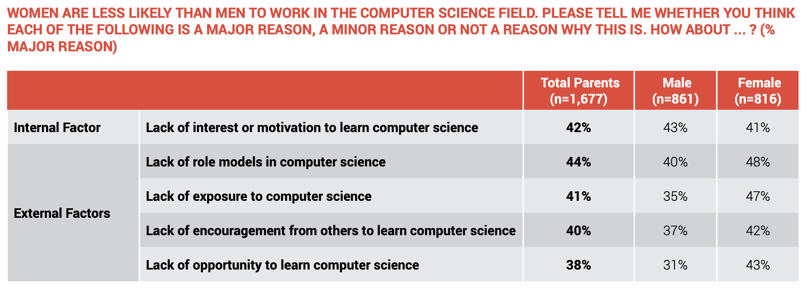
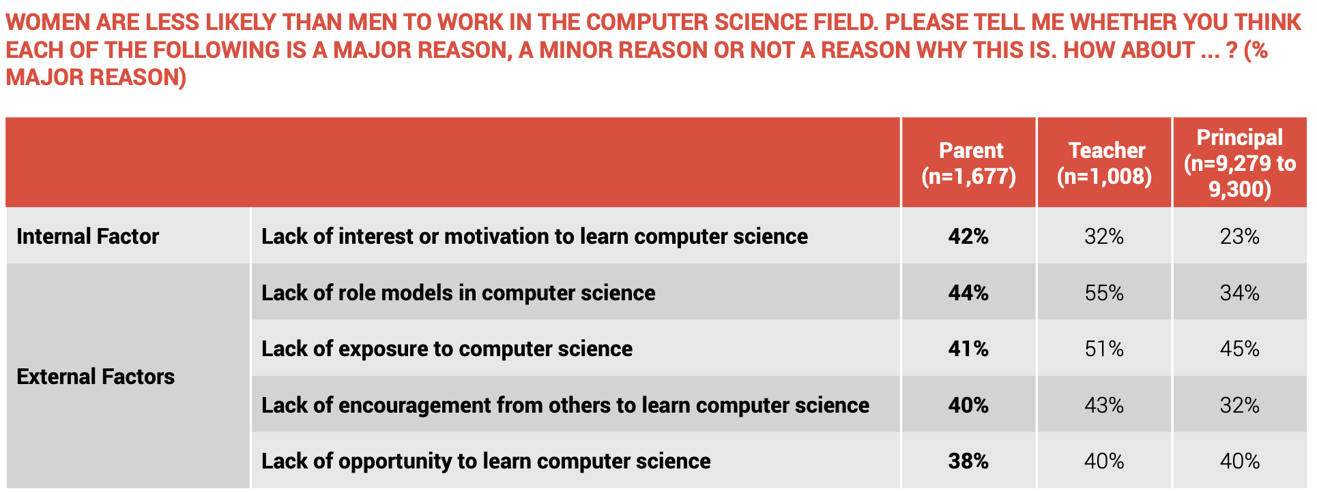
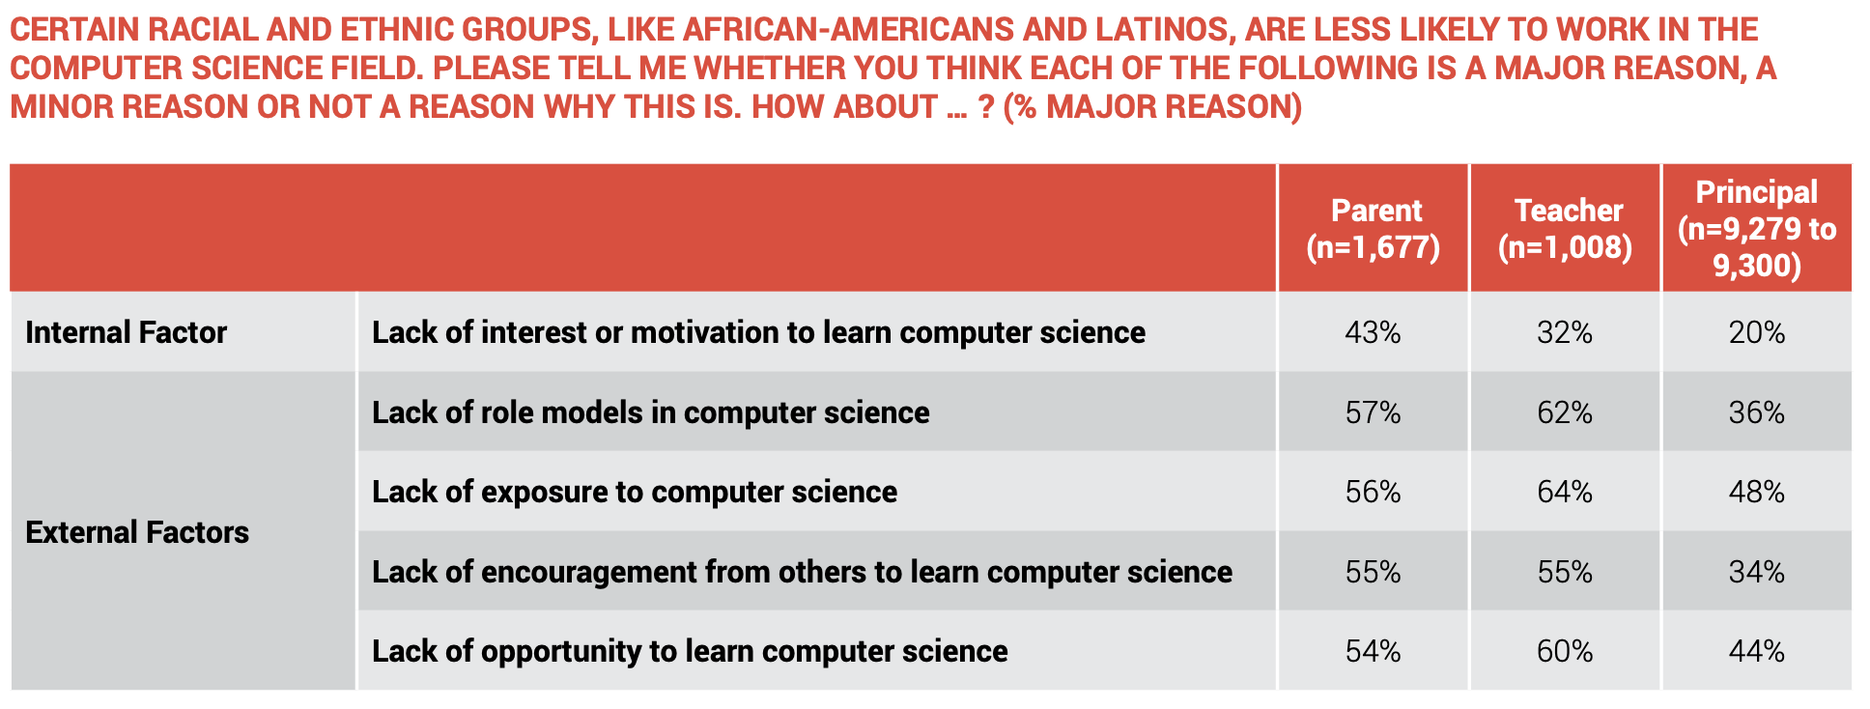

Slide 30
We Need to Close the Gaps
Source: Access Report

Slide 32
The Numbers
College and Workforce

Slide 33
Better but not Good
The rates of science and engineering course taking for girls/women shift at the undergraduate level and gender disparities begin to emerge, especially for minority women
Women make up half of the total U.S. college-educated workforce, but only 28% of the science and engineering workforce.
Women scientists and engineers are concentrated in different occupations than are men, with relatively high shares of women in the social sciences (60%) and biological, agricultural, and environmentallife sciences (48%) and relatively low shares in engineering (15%) and computer and mathematical sciences (26%).

Slide 34
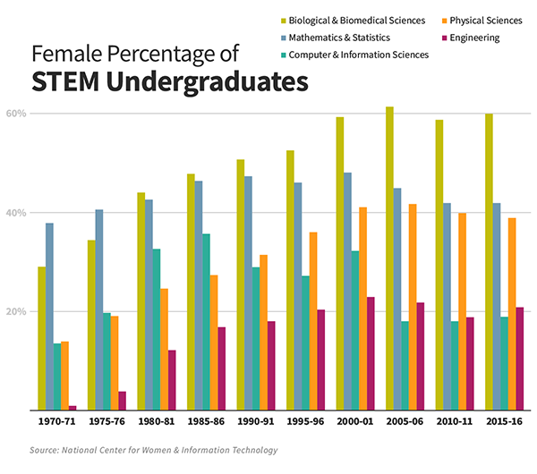
Representation in Computational Sciences is Especially Bad When Compared to Other STEM Majors

Slide 35
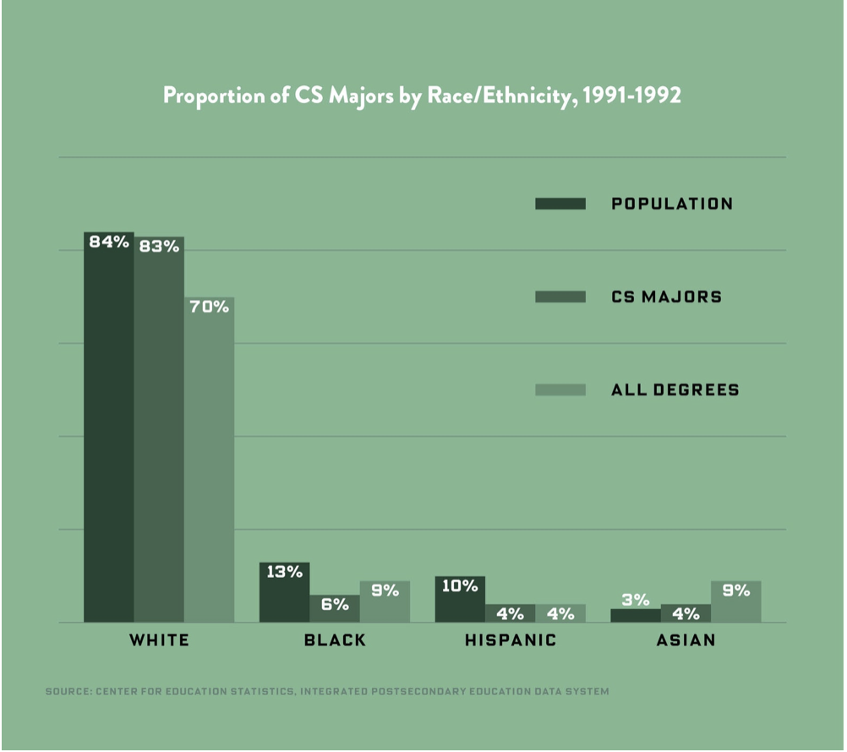
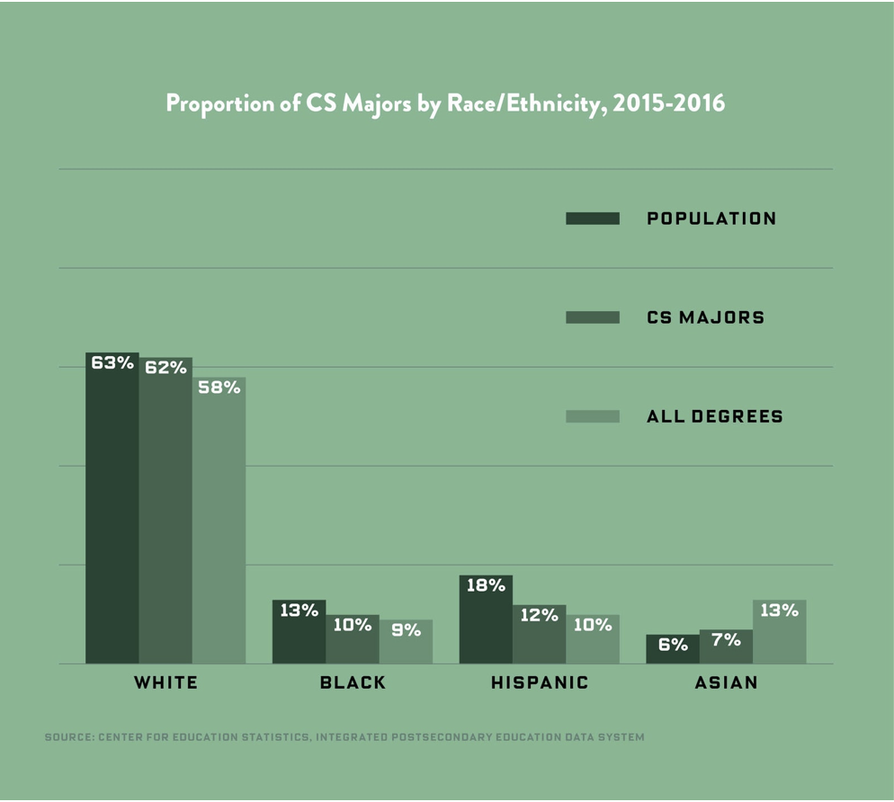
Representation in Computational Sciences Majors by Race or Ethnicity Change From 90s To 2016

Slide 36
Even When They End Up Making it Into University…
A third of minority students leave STEM majors
More than a third of black (40%) and Latino (37%) students switch majors before earning a degree, compared with 29% of white STEM students.
Another 26% of black STEM students and 20% of Latino STEM students drop out of college altogether—13 and seven percentage points higher, respectively, than white STEM students (13%), according to the study.

Slide 37
Why Do They Leave?
Black and Latino students are more likely to come from low-income families, they might not have access to the academic resources that traditionally help support students through to completion.
Researchers also speculate that discrimination and bias in STEM could be pushing minority students away from the field. After all, black and Latino students don’t leave other competitive majors, such as business, at the same high rates, note the researchers
Same for women. Women aren’t underrepresented in STEM because they dislike math or science, they’re underrepresented because they “don’t like to be discriminated against”
1. Ganley CM, George CE, Cimpian JR, Makowski MB. Gender Equity in College Majors: Looking Beyond the STEM/Non-STEM Dichotomy for Answers Regarding Female Participation. American Educational Research Journal. 2018;55(3):453-487. doi:10.3102/0002831217740221

Slide 38
Better but not Good
In 2015, 67% of workers in science and engineering occupations were white, which is close to the proportion in the U.S. working age population.
Hispanics, blacks, and American Indians/Alaska Natives make up a smaller share of the science and engineering workforce (11%) than their proportion in the general population (27% of U.S. working age population).
Asians work in science and engineering occupations at higher rates (20.6%) than their representation in the U.S. working-age population (5.5%). Asians are particularly highly concentrated in computer and information science occupations.
The increase in female participation in science and engineering over the past two decades includes increasing participation by members of all racial and ethnic groups, especially Hispanic and Asian women.

Slide 39
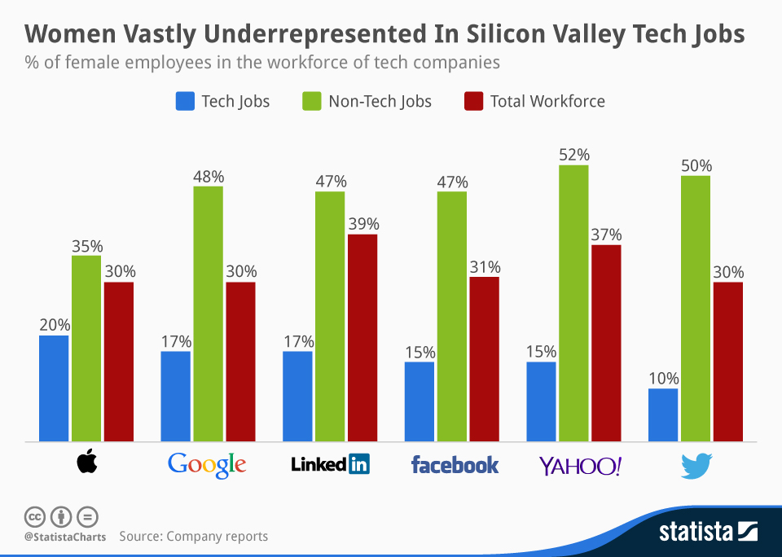
Even the Biggest Companies Have this Gap

Slide 40
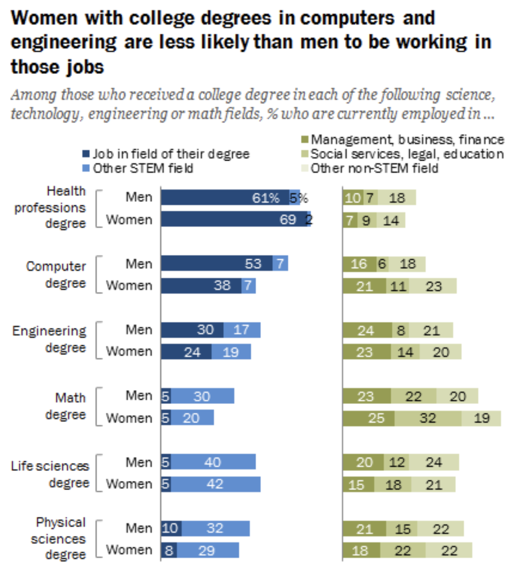
More Hurdles Even After Getting the Degree

Slide 41
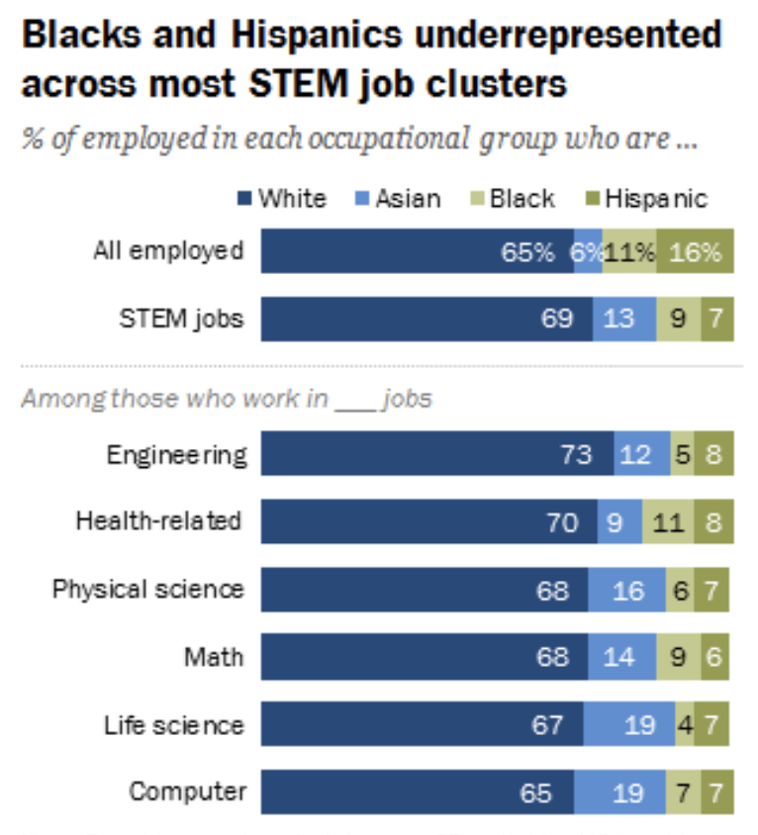
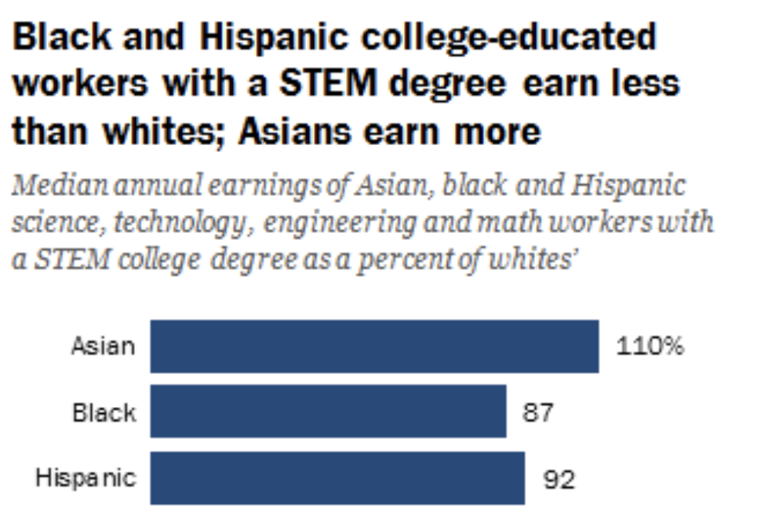
More Hurdles Even After Getting the Degree

Slide 42
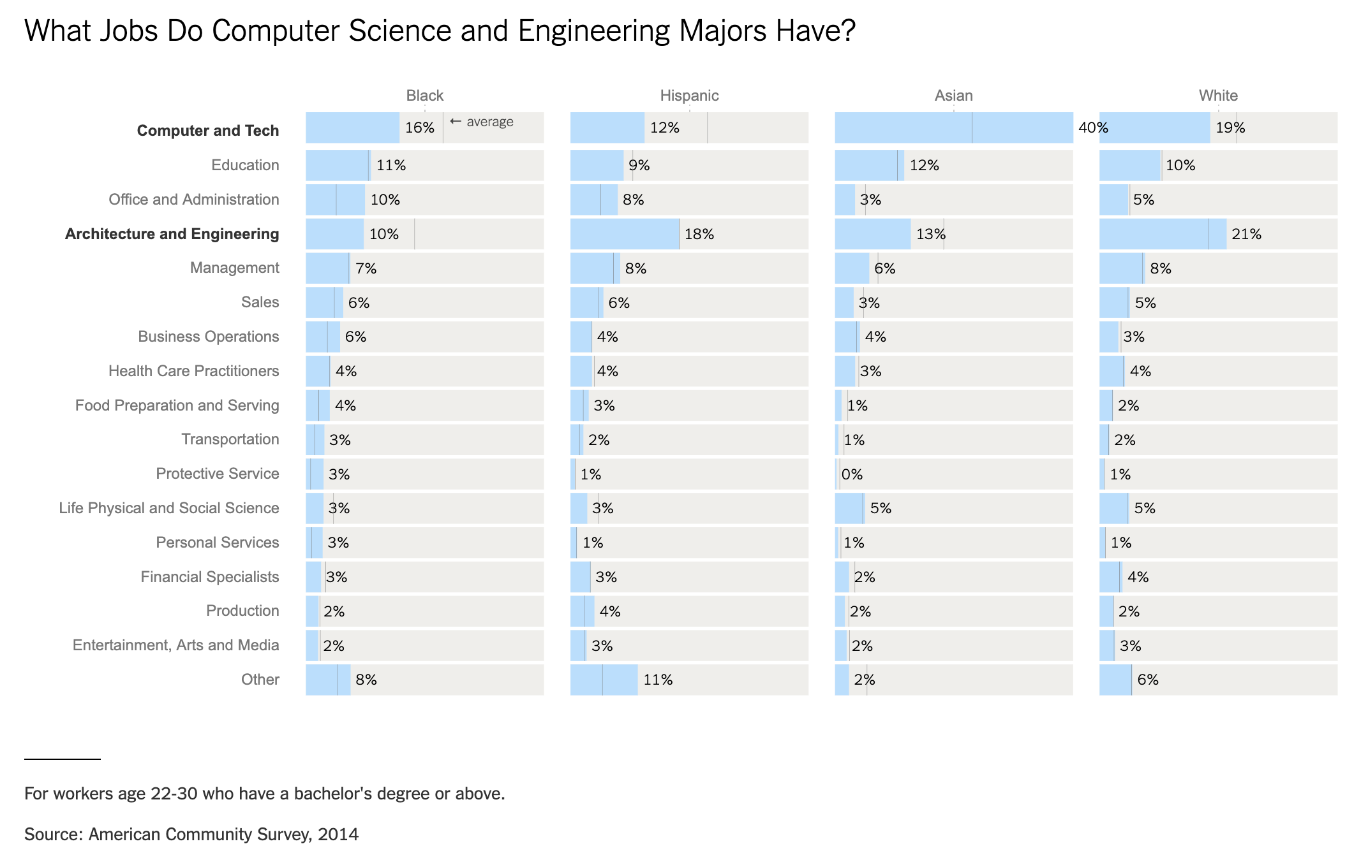
So What Jobs Do these Minorities With C.S. Degrees Have?

Slide 44
Sources not Listed on Slides
https://services.google.com/fh/files/misc/closing-computer-science-learning-gaps-blackstudents.pdf
https://services.google.com/fh/files/misc/closing-computer-science-learning-gaps-hispanicstudents.pdf
https://services.google.com/fh/files/misc/closing-computer-science-learning-gaps-rural-and-small-town-school-districts.pdf
https://services.google.com/fh/files/misc/closing-computer-science-learning-gaps-girls.pdf
https://eab.com/insights/daily-briefing/student-success/a-third-of-minority-students-leave-stem-majors-heres-why/
https://www.govtech.com/workforce/Black-Latino-People-Are-Being-Left-Out-of-the-Tech-Workforce.html
https://www.washingtonpost.com/local/education/the-science-divide-why-do-latino-and-black-students-leave-stem-majors-at-higher-rates/2019/05/03/e386d318-4b32-11e9-93d0-64dbcf38ba41_story.html
Based on the Diversity Gaps in Computer Science: Exploring the Underrepresentation of Girls, Blacks and Hispanics report by Gallup (2016)
https://services.google.com/fh/files/misc/diversity-gaps-in-computer-science-report.pdf

